Slide 1
Numerical Algorithms
x
0
1
2
3
4
5
6
7
8
9
x⁻¹
1
7
3
9

Slide 2
Outline
Divisibility and primes
Modular arithmetic
Euclid’s GCD algorithm
Multiplicative inverses
Powers
Fermat’s little theorem
Euler’s theorem

Slide 3
Facts About Numbers
Prime number p:
  p is an integer
  p ≥ 2
  The only divisors of p are 1and p
Examples
  2, 7, 19 are primes
  −3, 1, 6 are not primes
Fundamental Theorem of Arithmetic : Any positive integer n can be decomposed uniquely into a product of primes called the prime decomposition of n.
n = p₁e1 × … × p_{k}^{e}k
Example:
  200 = 2³ × 5²

Slide 4
Greatest Common Divisor
The greatest common divisor (GCD) of two positive integers a and b, denoted gcd(a, b), is the largest positive integer that divides both a and b
The above definition is extended to arbitrary integers
Examples:
  gcd(18, 30) = 6 gcd(0, 20) = 20
  gcd(−21, 49) = 7
Two integers a and b are said to be relatively prime if gcd(a, b) = 1
Example:
  Integers 15 and 28 are relatively prime

Slide 5
GCD
Theorem 10.3 For any positive integers a and b, gcd(a,b) is the smallest positive integer d such that d = ia + jb for some integers i and j.
Proof: Suppose d is the smallest integer such that d = ia + jb for integers i and j.
  From the definition of d, any divisor of both a and b is also a divisor of d. Thus d ≥ gcd(a,b).
  Let h = floor(a/d). Thus, h is the integer such that a mod d = a =hd. Then
a mod d = a -hd = a -h(ia+jb) = (1-hi)a + (-hj)b and a mod d is a linear combination of i and j. Since d is the smallest positive integer with this property, a mod d =0 and d|a. Similarly, we can show d|b. Thus, d is a divisor of both a and b and d ≤ gcd(a,b).

Slide 6
Euclid's GCD Algorithm
Lemma 10.4: For a and b two positive integer, for any integer r we have
gcd(a,b) = gcd(b,a-rb)
Proof: Let d = gcd(a,b) and c = gcd(b,a-rb). So d is the largest integer such that d|a and d|b and c is the largest integer such that c|b and c|(a-tb). We need to prove that c = d.
By the definition of d, (a-rb)d = a/d - r(b/d) is an integer. Thus, d|a and d|a-rb - so d ≤ c.
By the definition of c, k=b/c must be an integer since c|b. Thus, (a-rb)/c = a/c -rk is an integer because c|a-rb. So, a/c is an integer and c|a and c|b. Thus, c ≤ d and we have d=c.

Slide 7
Euclid's GCD Algorithm
Lemma 10.4 is the basis for the ancient algorithm known as Euclid's GCD Algorithm (which was seen twice in cpsc 171 - once in the first chapter and once in Scheme (where the recursive algorithm was introduced.)
Algorithm EuclidGCD(a,b)
Input positive integers a and b.; Output gcd(a,b)
If b = 0, return a
else return EuclidGCD(b, a mod b)
EX: gcd(412, 260) = 4
a | 412 | 260 | 152 | 108 | 44 | 20 | 4
b | 260 | 152 | 108 | 44 | 20 | 4 | 0

Slide 8
Modular Arithmetic
Modulo operator for a positive integer n
r = a mod n
equivalent to
a = r + kn
and
r = a − ⎣a/n⎦ n
Examples:
  29 mod 13 = 3 13 mod 13 = 0 −1 mod 13 = 12
  29 = 3 + 2×13 13 = 0 + 1×13 12 = −1 + 1×13
Modulo and GCD:
gcd(a, b) = gcd(b, a mod b)
Example:
  gcd(21, 12) = 3 gcd(12, 21 mod 12) = gcd(6, 9) = 3

Slide 9
Analysis
Let a_{i} and b_{i} be the arguments of the i-th recursive call of algorithm EuclidGCD
We have
a_{i + 2} = b_{i + 1} = a_{i} mod a_{i + 1} < a_{i + 1}
Sequence a₁, a₂, …, a_{n} decreases exponentially, namely
a_{i + 2} ≤ ½ a_{i} for i > 1
  Case 1 a_{i + 1} ≤ ½ a_{i} a_{i + 2} < a_{i + 1} ≤ ½ a_{i}
  Case 2 a_{i + 1} > ½ a_{i} a_{i + 2} = a_{i} mod a_{i + 1} = a_{i} − a_{i + 1} ≤ ½ a_{i}
Thus, the maximum number of recursive calls of algorithm EuclidGCD(a. b) is
1 + 2 log max(a. b)
Algorithm EuclidGCD(a, b) executes O(log max(a, b)) arithmetic operations

Slide 10
Binary Euclid's Algorithm
Integer division by 2 is much faster than division by a general integer since all we have to do is right-shift.
On page 457, there is a binary form of the gcd calculation which has complexity O(log max(a,b)) arithmetic operations.
That complexity is the same as for the usual algorithm
But, the binary algorithm has a smaller constant factor than the usual algorithm and will run somewhat faster.

Slide 11
Multiplicative Inverses (1)
The residues modulo a positive integer n are the set
Z_{n} = {0, 1, 2, …, (n − 1)}
Let x and y be two elements of Z_{n} such that
xy mod n = 1
We say that y is the multiplicative inverse of x in Z_{n} and we write y = x⁻¹
Example:
  Multiplicative inverses of the residues modulo 11
x | 0 | 1 | 2 | 3 | 4 | 5 | 6 | 7 | 8 | 9 | 10
x⁻¹ |  | 1 | 6 | 4 | 3 | 9 | 2 | 8 | 7 | 5 | 10

Slide 12
Modular Arithmetic
Theorem 10.6. An element x > 0 of Z_{n} has a multiplicative inverse in Z_{n} if and only if gcd(x,n) = 1.
Proof: (<==) Suppose gcd(x,n) =1. By Thm 10.3, there are integers i and j such that ix + jn= 1. This implies ix mod n = 1 -i.e. i mod n is the multiplicative inverse in Z_{n}.
(==>) Suppose we assume a contradiction - i.e. x > 1 divides n and there is an element y such that xy=1 mod n. Then xy=kn+1 for some integer k. Thus we have found i=y and j=-k such that ix + jn =1. By Theorem 10.3, this says gcd(x,n) = 1, a contradiction.

Slide 13
Multiplicative Inverses (2)
Theorem 10.6: An element x of Z_{n} has a multiplicative inverse if and only if x and n are relatively prime
Example
  The elements of Z₁₀ with a multiplicative inverse are 1, 3, 5, 7
Corollary : If is p is prime, every nonzero residue in Z_{p} has a multiplicative inverse
Theorem : A variation of Euclid’s GCD algorithm computes the multiplicative inverse of an element x of Z_{n} or determines that it does not exist
x
0
1
2
3
4
5
6
7
8
9
x⁻¹
1
7
3
9

Slide 14
Corollary 10.7 to Theorem 10.6
Let p be a prime. For each nonzero residue x of Z_{p}, the multiplicative inverse of x is x^{p − 2} mod p
Proof
x(x^{p − 2} mod p) mod p = xx^{p − 2} mod p = x^{p − 1} mod p = 1

Slide 15
Fermat’s Little Theorem
Theorem
Let p be a prime. For each nonzero residue x of Z_{p}, we have x^{p − 1} mod p = 1
Example (p = 5):
  1⁴ mod 5 = 1 2⁴ mod 5 = 16 mod 5 = 1
  3⁴ mod 5 = 81 mod 5 = 1 4⁴ mod 5 = 256 mod 5 = 1
Proof: It suffices to prove the result for 0 < x < p because x^{p-1} mod p = (x mod p)^{p-1} mod p.
  By Corollary 10.7, we know the set {1,2,...,p-1} and {1x,2x,...,(p-1)x} are the same set.
  So if we multiply the sets together, we get the same value, namely

Slide 16
Proof continued
{1,2,...,p-1} gives us 1*2*...*(p-1) = (p-1)!
{1x,2x,...,(p-1)x} gives us
1x *2x*...* (p-1)x=x^{p-1}(p-1)! = (p-1)! mod p
Since p is prime, every nonnull element in Z^{p} has a multiplicative inverse. Thus, we can cancel the (p-1)! term from both sides, giving us x^{p-1}= 1 mod p which is what we want.

Slide 17
Digression - Fermat's Last Theorem
Theorem: If an integer n is greater than 2, then the equation a^{n} + b^{n} = c^{n} has no solutions in non-zero integers a, b, and c.
In 1637 Pierre de Fermat wrote, in his copy of the famous Arithmetica of Diophantus, "I have a truly marvellous proof of this proposition which this margin is too narrow to contain.
Fermat's Last Theorem is strikingly different and much more difficult to prove than the analogous problem for n = 2, for which there are infinitely many integer solutions called Pythagorean triples (and the closely related Pythagorean theorem has many elementary proofs).

Slide 18
Digression - Fermat's Last Theorem
That the problem's statement is understandable by schoolchildren made it all the more frustrating, and it has possibly generated more incorrect proofs than any other problem in the history of mathematics.
No correct proof was found for 357 years, until one was finally released by Andrew Wiles in October 1994. Starting in the summer of 1986, based on successive progress of the previous few years of other researchers, Wiles dedicated all of his research time to this problem in relative secrecy. By 1995, he had released a surprisingly lengthy proof of Fermat's Last Theorem that has stood up to the scrutiny of the world's experts.

Slide 19
Conjecture vs Theorem
The term "Last Theorem" resulted because all the other theorems and results proposed by Fermat were eventually proved or disproved, either by his own proofs or by those of other mathematicians, in the two centuries following their proposition.
Although it is a theorem now that it has been proved, the status of Fermat's Last Theorem before then, in spite of the name, was that of a conjecture, a mathematical statement whose status (true or false) had not been conclusively settled.

Slide 20
Powers
Let p be a prime
The sequences of successive powers of the elements of Z_{p} exhibit repeating subsequences
The sizes of the repeating subsequences and the number of their repetitions are the divisors of p − 1
Example (p = 7)
x | x² | x³ | x⁴ | x⁵ | x⁶
1 | 1 | 1 | 1 | 1 | 1
2 | 4 | 1 | 2 | 4 | 1
3 | 2 | 6 | 4 | 5 | 1
4 | 2 | 1 | 4 | 2 | 1
5 | 4 | 6 | 2 | 3 | 1
6 | 1 | 6 | 1 | 6 | 1

Slide 21
The Totient Function of n
The multiplicative group for Z_{n}, denoted with Z*_{n}, is the subset of elements of Z_{n} relatively prime with n
The totient function of n, denoted with φ(n), is the size of Z*_{n}
Example
  Z*₁₀ = { 1, 3, 7, 9 } φ(10) = 4
If p is prime, we have
Z*_{p} = {1, 2, …, (p − 1)} φ(p) = p − 1

Slide 22
Euler’s Theorem
Theorem
For each element x of Z*_{n}, we have
x^{φ(n)} mod n = 1
Example (n = 10) - Recall φ(10) = 4
  3^{φ(10)} mod 10 = 3⁴ mod 10 = 81 mod 10 = 1
  7^{φ(10)} mod 10 = 7⁴ mod 10 = 2401 mod 10 = 1
  9^{φ(10)} mod 10 = 9⁴ mod 10 = 6561 mod 10 = 1
The proof is very similar to Fermat's Little Theorem.

Slide 23
Modular Exponentiation
We want a method better than brute force in computing exponents for modulo arithmetic.
Observing that squaring a^p is equivalent to multiplying its exponent p by 2.
And, multiplying a^p and a^q is equivalent to computing a^(p+q).
Algorithm: FastExpo(a,p,n) pg 463
Computes r = a^p mod n in O(log p) operations.
If p = 0, return 1.
If p is even, compute t ← FastExpo(a, p/2,n)
If p is odd, compute t ← FastExpo(a,(p-1)/2,n)
Return a(t^2) mod n) mod n

Slide 24
Fast Exponentiation
Algorithm: FastExpo(a,p,n) - pg 463
Input: Integers a,p,n
Output: r = a^p mod n
if p=0, return 1
if p is even,
t = FastExpo(a,p/2,n)
return t^2 mod n
//p is even so t = a^(p/2) mod n
else
t = FastExpo*a,(p-1)/2,n)
return a(t^2mod n) mod n

Slide 25
Fast Exponentiation
The size of operands are kept under control as we mod at each step.
The size of the operands on each multiplication and mod operation is never more than
2(ceiling logn) bits
Example:
p | 12 | 6 | 3 | 1 | 0
r | 1 | 12 | 8 | 2 | 1

Slide 26
Extended Euclid's Algorithm
Let a and b be two positive integers. The extended algorithm for computing a triplet of integers (d, i, j) such that
  d = gcd(a,b) = ia +jb
  executes O(log max(a+b) arithmetic operations.
  See pg 465 for the exact algorithm and a proof it works.

Slide 27
Cryptography
plaintext
encrypt
ciphertext

Slide 28
Outline
Traditional cryptography
Statistical attacks
Secret-key encryption
Public-key encryption

Slide 29
Encryption
Scenario:
  Alice wants to send a message (plaintext p) to Bob.
  The communication channel is insecure and can be eavesdropped.
  If Alice and Bob have previously agreed on an encryption scheme (cipher), the message can be sent encrypted (ciphertext c)
plaintext
encrypt
ciphertext
decrypt
plaintext

Slide 30
Encryption
Issues:
  What is a good encryption scheme?
  What is the complexity of encrypting/decrypting?
  What is the size of the ciphertext, relative to the plaintext?
  If Alice and Bob have never interacted before, how can they agree on an encryption scheme?
plaintext
encrypt
ciphertext
decrypt
plaintext

Slide 31
Traditional Cryptography
Ciphers were already studied in ancient times
Caesar’s cipher:
  replace a with d
  replace b with e
  ...
  replace z with c
Caesar’s cipher is an example of a monoalphabetic substitution cipher, which permutes the characters

Slide 32
Traditional Cryptography
Armed with simple statistical knowledge, one can easily break a monoalphabetic substitution cipher
  most frequent letters in English: e, t, o, a, n, i, ...
  most frequent digrams: th, in, er, re, an, ...
  most frequent trigrams: the, ing, and, ion, ...
The first description of the frequency analysis attack appears in a book written in the 9th century by the Arab philosopher al-Kindi

Slide 33
Statistical Attacks
Example (S. Singh, The Code Book, 1999):
PCQ VMJYPD LBYK LYSO KBXBJXWXV BXV ZCJPO EYPD KBXBJYUXJ LBJOO KCPK. CP LBO LBCMKXPV XPV IYJKL PYDBL, QBOP KBO BXV OPVOV LBO LXRO CI SX'XJMI, KBO JCKO XPV EYKKOV LBO DJCMPV ZOICJO BYS, KXUYPD: “DJOXL EYPD, ICJ X LBCMKXPV XPV CPO PYDBLK Y BXNO ZOOP JOACMPLYPD LC UCM LBO IXZROK CI FXKL XDOK XPV LBO RODOPVK CI XPAYOPL EYPDK. SXU Y SXEO KC ZCRV XK LC AJXNO X IXNCMJ CI UCMJ SXGOKLU?”
OFYRCDMO, LXROK IJCS LBO LBCMKXPV XPV CPO PYDBLK

Slide 34
Frequency Analysis (1)
We identify the most common characters, digrams and trigrams in the ciphertext
Example
PCQ VMJYPD LBYK LYSO KBXBJXWXV BXV ZCJPO EYPD KBXBJYUXJ LBJOO KCPK. CP LBO LBCMKXPV XPV IYJKL PYDBL, QBOP KBO BXV OPVOV LBO LXRO CI SX'XJMI, KBO JCKO XPV EYKKOV LBO DJCMPV ZOICJO BYS, KXUYPD: “DJOXL EYPD, ICJ X LBCMKXPV XPV CPO PYDBLK Y BXNO ZOOP JOACMPLYPD LC UCM LBO IXZROK CI FXKL XDOK XPV LBO RODOPVK CI XPAYOPL EYPDK. SXU Y SXEO KC ZCRV XK LC AJXNO X IXNCMJ CI UCMJ SXGOKLU?”
OFYRCDMO, LXROK IJCS LBO LBCMKXPV XPV CPO PYDBLK
First guess: LBO is THE

Slide 35
Frequency Analysis (2)
Assuming LBO represents THE, we replace L with T, B with H, and O with E and get
PCQ VMJYPD THYK TYSE KHXHJXWXV HXV ZCJPE EYPD KHXHJYUXJ THJEE KCPK. CP THE THCMKXPV XPV IYJKT PYDHT, QHEP KHO HXV EPVEV THE LXRE CI SX'XJMI, KHE JCKE XPV EYKKEV THE DJCMPV ZEICJE HYS, KXUYPD: “DJEXT EYPD, ICJ X THCMKXPV XPV CPE PYDHTK Y HXNE ZEEP JEACMPTYPD TC UCM THE IXZREK CI FXKT XDEK XPV THE REDEPVK CI XPAYEPT EYPDK. SXU Y SXEE KC ZCRV XK TC AJXNE X IXNCMJ CI UCMJ SXGEKTU?”
EFYRCDME, TXREK IJCS THE THCMKXPV XPV CPE PYDBTK

Slide 36
Decryption
Code:
  X Z A V O I D B Y G E R S P C F H J K L M N Q T U W
  A B C D E F G H I J K L M N O P Q R S T U V W X Y Z
Ciphertext: PCQ VMJYPD LBYK LYSO KBXBJXWXV BXV ZCJPO EYPD KBXBJYUXJ LBJOO KCPK. CP LBO LBCMKXPV XPV IYJKL PYDBL, QBOP KBO BXV OPVOV LBO LXRO CI SX'XJMI, KBO JCKO XPV EYKKOV LBO DJCMPV ZOICJO BYS, KXUYPD: “DJOXL EYPD, ICJ X LBCMKXPV XPV CPO PYDBLK Y BXNO ZOOP JOACMPLYPD LC UCM LBO IXZROK CI FXKL XDOK XPV LBO RODOPVK CI XPAYOPL EYPDK. SXU Y SXEO KC ZCRV XK LC AJXNO X IXNCMJ CI UCMJ SXGOKLU?”
OFYRCDMO, LXROK IJCS LBO LBCMKXPV XPV CPO PYDBLK

Slide 37
Plaintext:
Now during this time Shahrazad had borne King Shahriyar three sons. On the thousand and first night, when she had ended the tale of Ma'aruf, she rose and kissed the ground before him, saying: “Great King, for a thousand and one nights I have been recounting to you the fables of past ages and the legends of ancient kings. May I make so bold as to crave a favour of your majesty?”
Epilogue, Tales from the Thousand and One Nights

Slide 38
Secret-Key Encryption
A secret-key cipher uses a unique key K to encrypt and decrypt
Caesar’s generalized cipher uses the modular addition of each character (viewed as an integer) with the key:
C[i] = P[i] + K mod m
P[i] = C[i] − K mod m
More secure secret-key encryption schemes have been devised in this century
Examples:
  DES 3DES IDEA BLOWFISH
With private-key encryption, a distinct secret key must be established for every pair of parties

Slide 39
Public-Key Encryption
Bob uses a pair of keys (K_{E},K_{D}) and
  makes key K_{E} public
  keeps key K_{D} private
Anyone can use the public key K_{E} to encrypt a plaintext into a ciphertext sent to Bob
Only Bob can decrypt the ciphertext using the private key K_{D}
The most popular encryption scheme is RSA, named after its inventors Rivest, Shamir, and Adleman (1978)
The RSA patent expired in 2000
public key
private key
plaintext
encrypt
ciphertext
decrypt
plaintext

Slide 40
The RSA Cryptosystem
One of the earliest public key cryptosystems. the Merkle-Hellman system, linked encryption to the knapsack problem which is NP-complete.
Unfortunately, the problems the system generates turned out to be a special case of the knapsack problem that could be solved easily.
So we have this subtlety - the encryption must be tied to a problem which is intractable.
Of course, what is intractable today, may not be intractable tomorrow!

Slide 41
The RSA Cryptosystem
Select two large primes, p and q.
Let n=pq and recall that φ(n) = (p-1)(q-1)
Encryption and decryption keys are chosen so that
  e and φ(n) are relatively prime
  ed = 1 mod φ(n)
The second condition means e is the multiplicative inverse of e mod φ(n).
The pair of values n and e form the public key, while d is the private key.
In practice, e is chosen either randomly or as one of 3, 17, or 65537.

Slide 42
Rules for Encryption and Decryption
Assume for simplicity that the plaintext is an integer M with 0 < M < n.
  If M is a string, we can concatenate the bits of its characters to get an integer.
The plaintext is encrypted into ciphertext C by computing
  C = Me mod n
The decryption is handled by a similar formula
  M = C^{d} mod n
The following theorem proves this is justified.

Slide 43
Theorem 10.21, pg 476
Let p and q be odd primes and define n = pq. Let e be relatively prime with φ(n) and let d by the multiplicative inverse of e modulo φ(n). For each integer x such that 0 < x < n, x^{ed} = x mod n.
Proof: Let y = x^{ed} mod n. We want to prove that y = x. Because of the way we have selected e and d, we can write ed = k φ(n) + 1, for some integer k. Thus we have,
y = x^{kφ(n)+1} mod n
There are two cases to consider-
x does not divide n
x does divide n

Slide 44
Proof continued
Case 1: x does not divide n.
  Rewrite y using
  y = x^{kφ(n)+1} mod n
  = xx^{kφ(n)} mod n
  = x(x^{φ(n)} mod n)^{k} mod n
  By Euler's Theorem, x^{φ(n)} mod n = 1 which implies
  y = x1^{k} mod n = x.
Case 2: x does divide n.
  Since n= pq and p and q are primes, x is a multiple of either p or q.
  WLOG, assume x is multiple of p, that is x = hp for some positive integer h.

Slide 45
Proof continued
Clearly x cannot be a multiple ofq as well, since otherwise x would be greater than n=pq which is a contradiction.
Thus, gcd(x,q) = 1 and by Euler's Theorem again,
x^{φ(n)}= 1 mod q
Since φ(n) = φ(q) φ(q), raising both sides of the above equation by φ(q), we have
x^{kφ(n)}= 1 mod q
and rewriting this we have
x^{kφ(n)}= 1 + iq for some integer i.

Slide 46
Proof continued
From the last slide: rewriting this we have
x^{kφ(n)}= 1 + iq for some integer i.
Multiply both sides of the equation by x and recall that x = hp and n = pq, then we have
x^{kφ(n)+1}= x + xiq
= x + hpiq
= x + (hi)n
Consequently, y = x^{kφ(n)+1} mod n = x
In either case, we have shown y = x and the proof is finished.

Slide 47
Breaking RSA
Even if we know e, we don't know d unless we know φ(n).
Most cryptography researchers believe that to break RSA we must compute φ(n) and that requires prime factoring n.
There is no proof that factoring is computationally difficult.
No one has been able to solve the problem quickly over the last 100 years, especially when n is large - say 200+ digits.
Interesting: Many were delighted when a network of computers was able to factor the ninth Fermat number, 2⁵¹² - 1 (only 155 digits)

Slide 48
Analysis of RSA
Each operation of encryption or decryption requires a constant number of modular exponentiation operations which can be performed by method FastExpo.
Thus, the operations require O(logn) arithmetic operations!

Slide 49
Setup of RSA
This is harder, but there is a lot of software out there that performs the work.
The work is in computing the private and public keys.
For this to work, we must be able to easily determine whether or not a number is prime (called a primality test).
You don't want to use Sieve of Eratosthenes!
Perhaps we can use the fact that a^(p-1) = 1 mod p to generate primes.
Unfortunately, there are numbers such that
a^(n-1)=1 mod n, but n is not prime.

Slide 50
Carmichael Numbers
These numbers satisfy
a^(n-1)=1 mod n
for all 1 ≤ a ≤ n-1, but a is composite.
These ruin this as a test for prime numbers.
Two such numbers are 561 and 1105.

Slide 51
Primality Testing (Probability-based)
Let n be an odd integer that we want to test for primality.
Let witness(x,n) be a Boolean function of a random variable x and n with the following properties:
  If n is prime, then witness(x,n) is always false.
  So, if witness(x,n) is true, a is definitely composite.
  If n is composite, then witness(x,n) is falsw with probability q < 1.

Slide 52
The Function Witness

Slide 53
Information Security
message
M
one-way hash
fingerprint
f = H(M)

Slide 54
Outline and Reading
Digital signatures
  Definition (§10.2.2)
  RSA signature and verification (§10.2.3)
One-way hash functions
  Definition (§10.3.1)
  Applications (§10.3.2)
Key distribution
  Certificates (§10.3.5)
  Revocation (§10.3.5)

Slide 55
Digital Signature
A digital signature is a string S associated with a message M and the author A of M that has the following properties
  Integrity: S establishes that M has not been altered
  Nonrepudiation: S unequivocally identifies the author A of M and proves that A did indeed sign M
A digital signature scheme provides algorithms for
  Signing a message by the author
  Verifying the signature of a message by the reader
A recently passed law in the US gives digital signatures the same validity of handwritten signatures
A public-key cryptosystem yields a digital signature scheme provided encrypt(K_{E}, decrypt(K_{D}, M)) = M
  Signature: Alice (author) computes S = decrypt(K_{D},M) using her private key K_{D} and sends the pair (M,S) to Bob
  Verification: Bob (reader) computes M´ = encrypt(K_{E}, S) using Alice’s public key K_{E} and checks that M´ = M

Slide 56
RSA Digital Signature
Setup:
  n = pq, with p and q primes
  e relatively prime to
  φ(n) = (p − 1) (q − 1)
  d inverse of e in Z_{φ(n)}
Keys:
  Public key: K_{E} = (n, e)
  Private key: K_{D} = d
Signature:
  Message M in Z_{n}
  Signature S = M^{d} mod n
Verification:
  Check that M = S^{e} mod n
Setup:
  p = 5, q = 11
  n = 5⋅11 = 55
  φ(n) = 4⋅10 = 40
  e = 3
  d = 27 (3⋅27 = 81 = 2⋅40 + 1)
Keys:
  Public key: K_{E} = (55, 3)
  Private key: K_{D} = 27
Signature:
  M = 51
  S = 51²⁷ mod 55 = 6
Verification:
  S = 6³ mod 55 = 216 mod 55 = 51

Slide 57
One-Way Hash Function
A one-way hash function is a function H with the following properties
  M maps a string M of arbitrary length into an integer f = H(M) with a fixed number of bits, called the fingerprint or digest of M
  H can be computed efficiently
  Given an integer f, it is computationally infeasible to find a string M such that that H(M) = d
  Given a string M , it is computationally infeasible to find another string M´ such that H(M) = H(M´) (collision resistance)
  It is computationally infeasible to find two strings M and M´ such that H(M) = H(M´) (strong collision resistance)
Two widely used one-way hash functions are
  MD5 (Message Digest 5, 1992), which uses a 128-bit (16 bytes) fingerprint
  SHA-1 (Secure Hash Algorithm 1, 1995), which uses a 160-bit (20 bytes) fingerprint

Slide 58
Coin Flipping Over the Net
Alice and Bob want to flip a random coin by communicating over the internet
The following protocol, based on a one-way hash function H, ensures the fairness of the outcome
  Alice picks a random integer x, computes the fingerprint f = H(x) and sends f to Bob
  Bob sends to Alice his guess of whether x is odd or even
  Alice announces the result of the coin flip: heads if Bob has guessed correctly and tails otherwise
  Alice sends to Bob integer x as a proof of the outcome of the flip
  Bob verifies that f = H(x)
Because of the strong-collision resistance property, it is computationally infeasible for Alice to cheat

Slide 59
Digitally Signed Fingerprints
In the RSA digital signature scheme with modulus n, the message to be signed must be an integer in Z_{n} , i.e., the message should have at most b = log n bits
To overcome the above restriction on the message length, we can use the fingerprint f = H(M) of the message instead of the message itself, where H is a one-way hash function
  Alice computes first f = H(M) and then the signature S of f
  Bob first computes f = H(M) and then verifies S
Since the one-way hash function H has the collision-resistance property, it is computationally infeasible to modify the message M while preserving the signature of the fingerprint f = H(M)
message
M
one-way hash
fingerprint
f = H(M)
sign
signature
S = f ^{d} mod n

Slide 60
Certificates
Public-key cryptography is based on the knowledge by each participant of the public key of the other participants
It is complicated to securely distribute the public keys of all the participants
A certificate is a message of the type (name, public key) signed by a third-party
Public-key infrastructure (PKI)
  An entity trusted by all the participants, called certification authority (CA), issues to each participant a certificate (Name, K_{E}) that authoritatively binds the participants to their public keys
  Only the CA’s public key needs to be distributed securely
  Before sending an encrypted message to Bob or verifying a message digitally signed by Bob, Alice determines Bob’s public key K_{E} by using Bob’s certificate (Bob, K_{E})

Slide 61
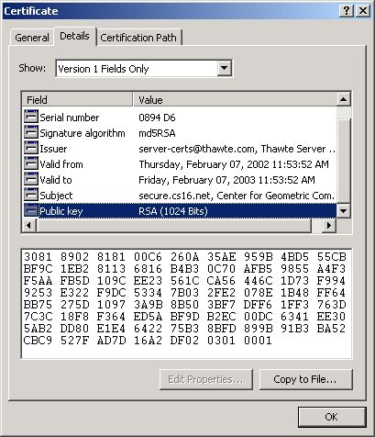
Web Server Certificates
A Web server certificate is used to authenticate the public key of a Web server
Fields of a Web server certificate
  Serial number
  Hash and signature schemes (e.g., MD5 and RSA)
  Issuer (certification authority)
  Period of validity (from, to)
  Subject (URL and organization)
  Public key
The SSL (secure socket layer) protocol uses Web server certificates to provide encryption and authentication in a secure Web connection (https)

Slide 62
Certificate Revocation
In certain circumstances, a certificate may have to be revoked before its expiration date
  The private key of the subject has been compromised
  The certificate was incorrectly issued by the CA
Certificate Revocation List (CRL)
  Time-stamped list of all the unexpired certificates that have been revoked by the CA
  Periodically published and signed by the CA
When presented with a certificate, one should
  Verify the CA’s signature on the certificate
  Check that the certificate has non been revoked by searching in the latest available CRL
By default, Web browsers do not check the revocation status of a Web server certificate, which poses a security risk

Slide 63
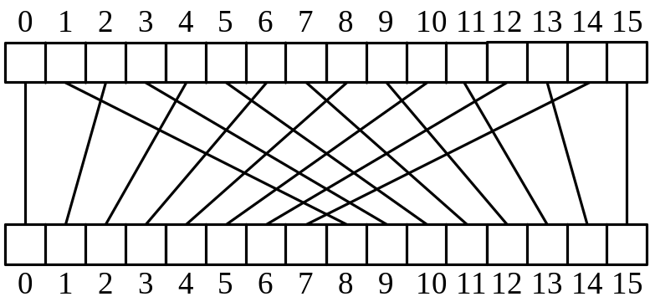
The Fast Fourier Transform

Slide 64

Outline and Reading
Polynomial Multiplication Problem
Primitive Roots of Unity (§10.4.1)
The Discrete Fourier Transform (§10.4.2)
The FFT Algorithm (§10.4.3)
Integer Multiplication (§10.4.4)
Java FFT Integer Multiplication (§10.5)

Slide 65

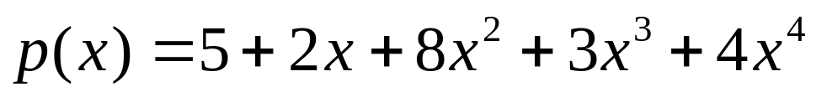
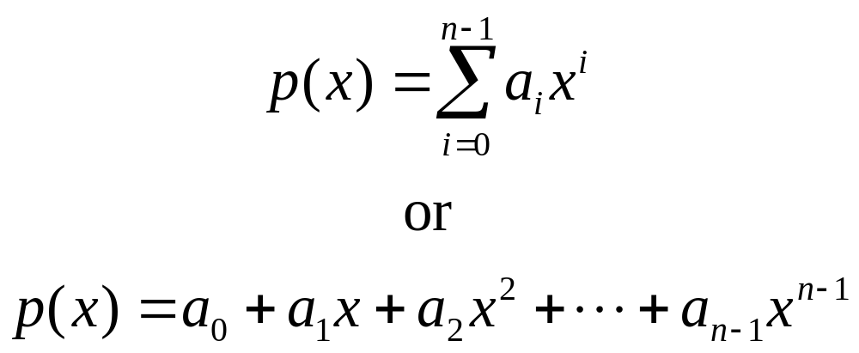
Polynomials
Polynomial:
In general,

Slide 66

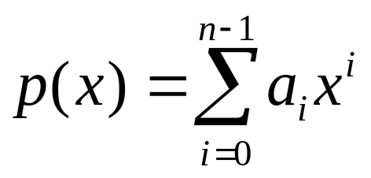
Polynomial Evaluation
Horner’s Rule:
  Given coefficients (a₀,a₁,a₂,…,a_{n-1}), defining polynomial
  Given x, we can evaluate p(x) in O(n) time using the equation
Eval(A,x): [Where A=(a₀,a₁,a₂,…,a_{n-1})]
  If n=1, then return a₀
  Else,
    Let A’=(a₁,a₂,…,a_{n-1}) [assume this can be done in constant time]
    return a₀+x*Eval(A’,x)

Slide 67
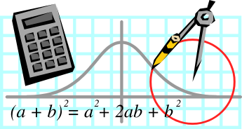
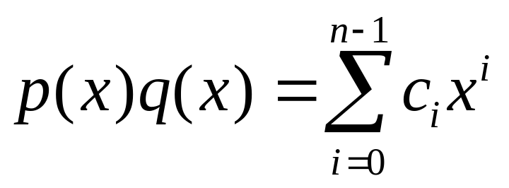
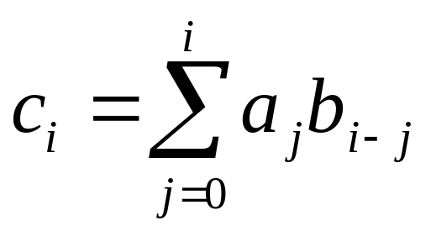
Polynomial Multiplication Problem
Given coefficients (a₀,a₁,a₂,…,a_{n-1}) and (b₀,b₁,b₂,…,b_{n-1}) defining two polynomials, p() and q(), and number x, compute p(x)q(x).
Horner’s rule doesn’t help, since
  where
A straightforward evaluation would take O(n²) time. The “magical” FFT will do it in O(n log n) time.

Slide 68
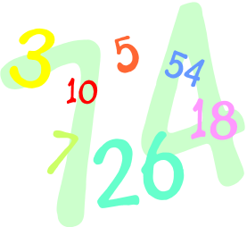
Polynomial Interpolation & Polynomial Multiplication
Given a set of n points in the plane with distinct x-coordinates, there is exactly one (n-1)-degree polynomial going through all these points.
Alternate approach to computing p(x)q(x):
  Calculate p() on 2n x-values, x₀,x₁,…,x_{2n-1}.
  Calculate q() on the same 2n x values.
  Find the (2n-1)-degree polynomial that goes through the points {(x₀,p(x₀)q(x₀)), (x₁,p(x₁)q(x₁)), …, (x_{2n-1},p(x_{2n-1})q(x_{2n-1}))}.
Unfortunately, a straightforward evaluation would still take O(n²) time, as we would need to apply an O(n)-time Horner’s Rule evaluation to 2n different points.
The “magical” FFT will do it in O(n log n) time, by picking 2n points that are easy to evaluate…

Slide 69
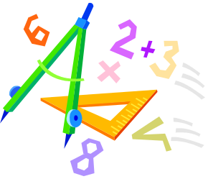
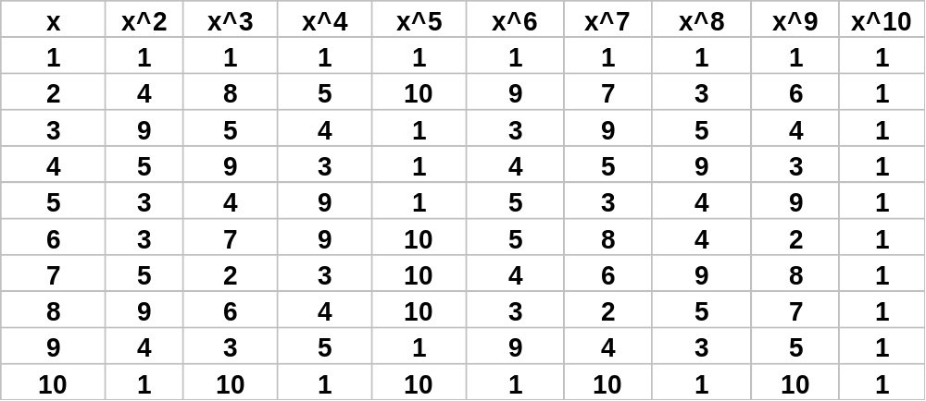

Primitive Roots of Unity
A number ω is a primitive n-th root of unity, for n>1, if
  ω^{n} = 1
  The numbers 1, ω, ω², …, ω^{n-1} are all distinct
Example 1:
  Z*₁₁:
  2, 6, 7, 8 are 10-th roots of unity in Z*₁₁
  2²=4, 6²=3, 7²=5, 8²=9 are 5-th roots of unity in Z*₁₁
  2⁻¹=6, 3⁻¹=4, 4⁻¹=3, 5⁻¹=9, 6⁻¹=2, 7⁻¹=8, 8⁻¹=7, 9⁻¹=5
Example 2: The complex number e^{2πi/n} is a primitive n-th root of unity, where

Slide 70

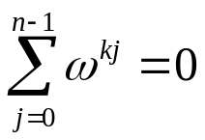
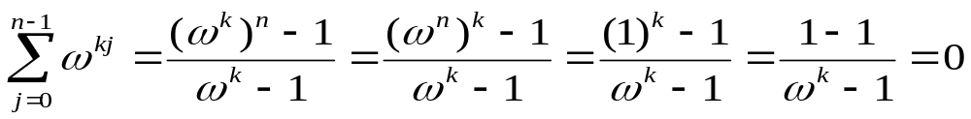
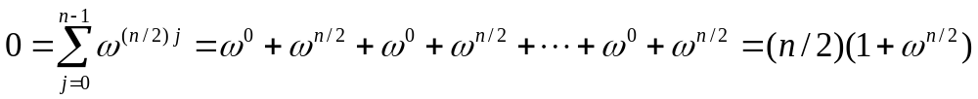
Properties of
Primitive Roots of Unity
Inverse Property: If ω is a primitive root of unity, then ω ⁻¹=ω^{n-1}
  Proof: ωω^{n-1}=ω^{n}=1
Cancellation Property: For non-zero -n<k<n,
  Proof:
Reduction Property: If w is a primitve (2n)-th root of unity, then ω² is a primitive n-th root of unity.
  Proof: If 1,ω,ω²,…,ω^{2n-1} are all distinct, so are 1,ω²,(ω²)²,…,(ω²)^{n-1}
Reflective Property: If n is even, then ω^{n/2} = -1.
  Proof: By the cancellation property, for k=n/2:
  Corollary: ω^{k+n/2}= -ω^{k}.

Slide 71
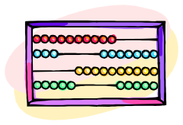
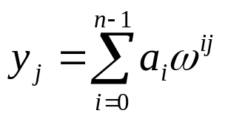
The Discrete Fourier Transform
Given coefficients (a₀,a₁,a₂,…,a_{n-1}) for an (n-1)-degree polynomial p(x)
The Discrete Fourier Transform is to evaluate p at the values
  1,ω,ω²,…,ω^{n-1}
  We produce (y₀,y₁,y₂,…,y_{n-1}), where y_{j}=p(ω^{j})
  That is,
  Matrix form: y=Fa, where F[i,j]=ω^{ij}.
The Inverse Discrete Fourier Transform recovers the coefficients of an (n-1)-degree polynomial given its values at 1,ω,ω²,…,ω^{n-1}
  Matrix form: a=F ⁻¹y, where F ⁻¹[i,j]=ω^{-ij}/n.

Slide 72

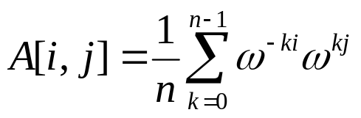
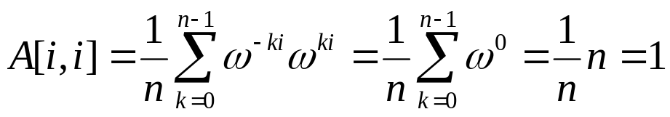
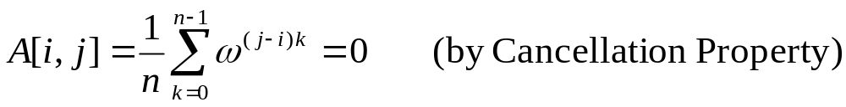
Correctness of the inverse DFT
The DFT and inverse DFT really are inverse operations
Proof: Let A=F ⁻¹F. We want to show that A=I, where
If i=j, then
If i and j are different, then

Slide 73

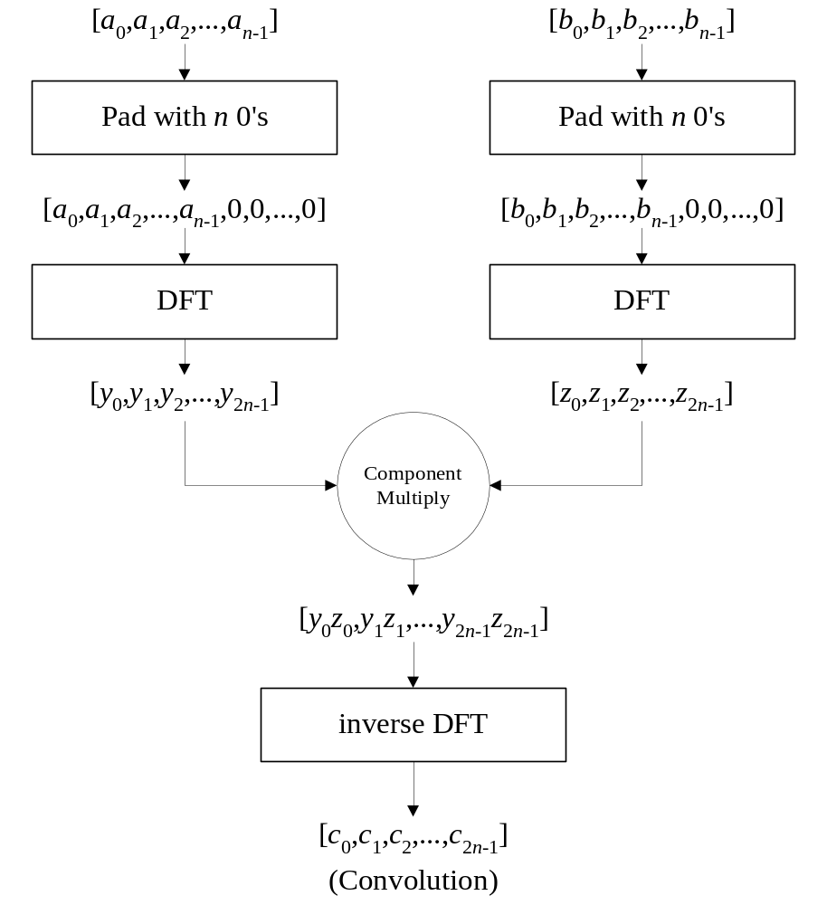
Convolution
The DFT and the inverse DFT can be used to multiply two polynomials
So we can get the coefficients of the product polynomial quickly if we can compute the DFT (and its inverse) quickly…

Slide 74
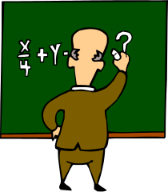

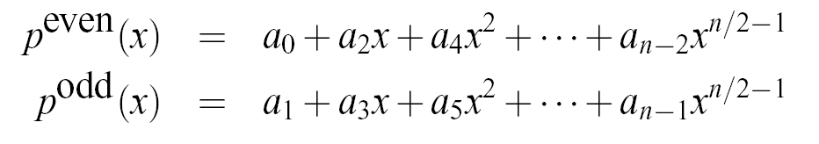

The Fast Fourier Transform
The FFT is an efficient algorithm for computing the DFT
The FFT is based on the divide-and-conquer paradigm:
  If n is even, we can divide a polynomial
  into two polynomials
  and we can write

Slide 75

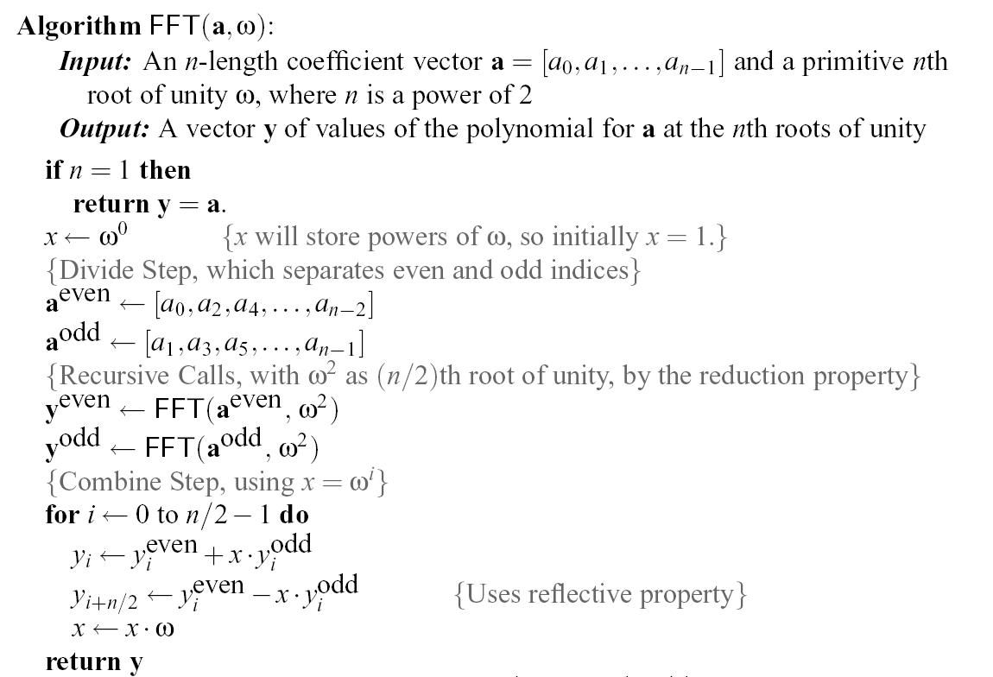
The FFT Algorithm
The running time is O(n log n). [inverse FFT is similar]

Slide 76

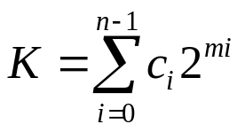
Multiplying Big Integers
Given N-bit integers I and J, compute IJ.
Assume: we can multiply words of O(log N) bits in constant time.
Setup: Find a prime p=cn+1 that can be represented in one word, and set m=(log p)/3, so that we can view I and J as n-length vectors of m-bit words.
Finding a primitive root of unity.
  Find a generator x of Z*_{p}.
  Then ω=x^{c} is a primitive n-th root of unity in Z*_{p} (arithmetic is mod p)
Apply convolution and FFT algorithm to compute the convolution C of the vector representations of I and J.
Then compute
K is a vector representing IJ, and takes O(n log n) time to compute.

Slide 77

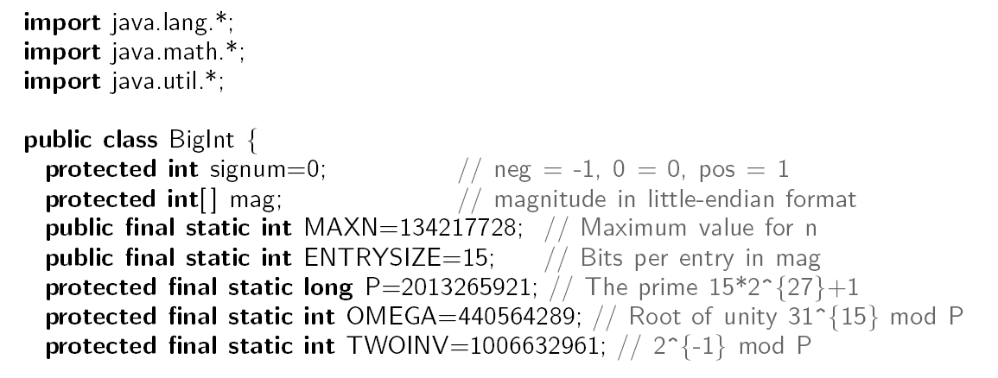
Java Example:
Multiplying Big Integers
Setup: Define BigInt class, and include essential parameters, including the prime, P, and primitive root of unity, OMEGA.
10;

Slide 78

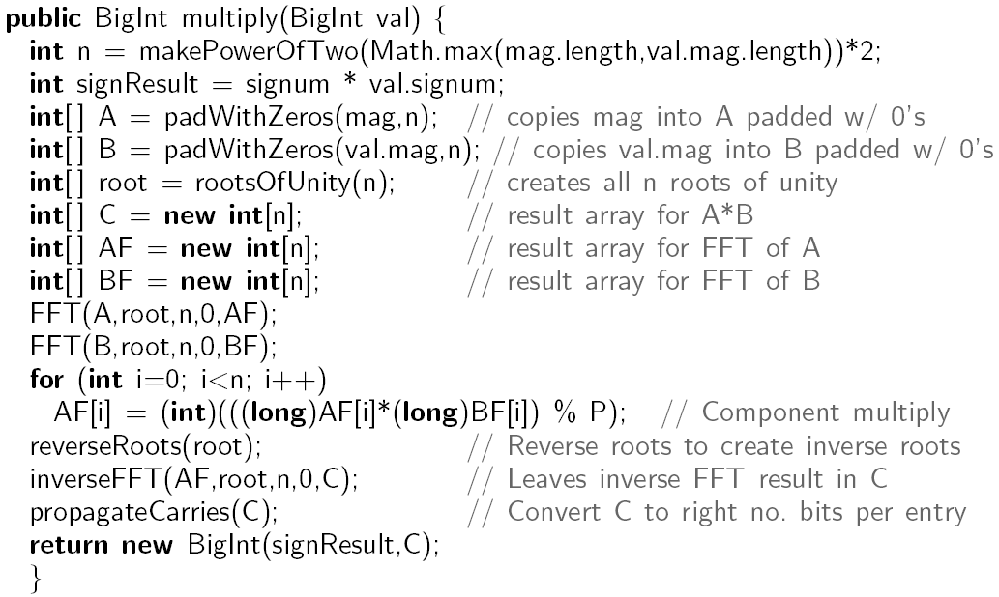
Java Integer Multiply Method
Use convolution to multiply two big integers, this and val:

Slide 79

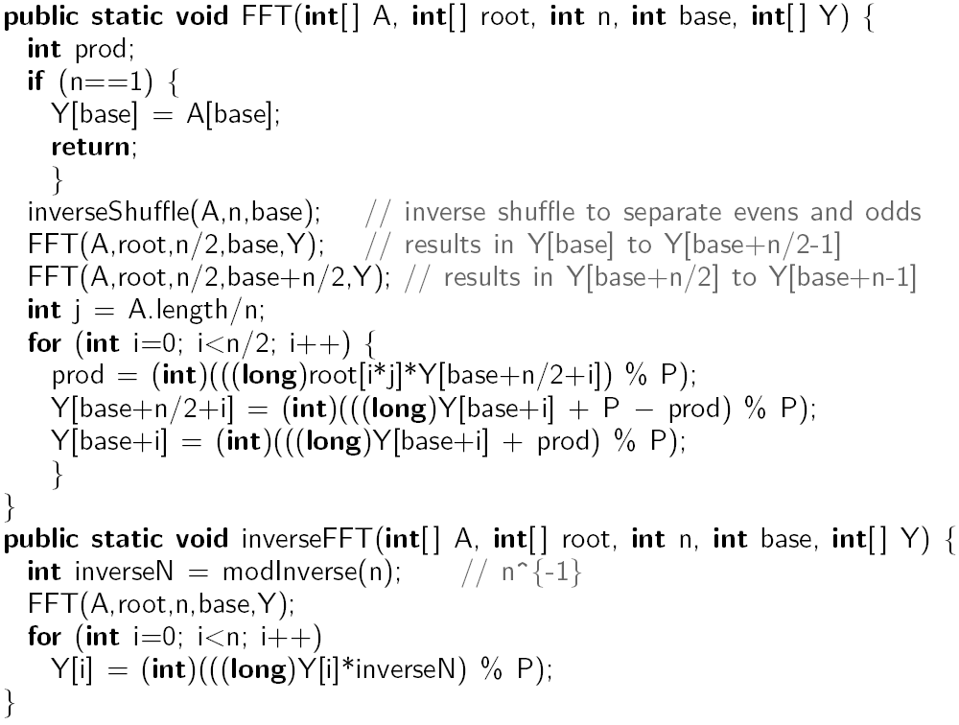
Java FFT in Z*_{p}

Slide 80

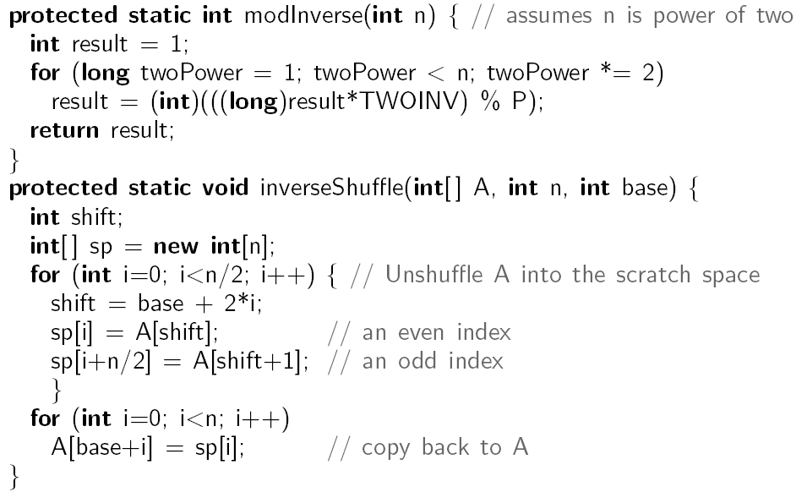
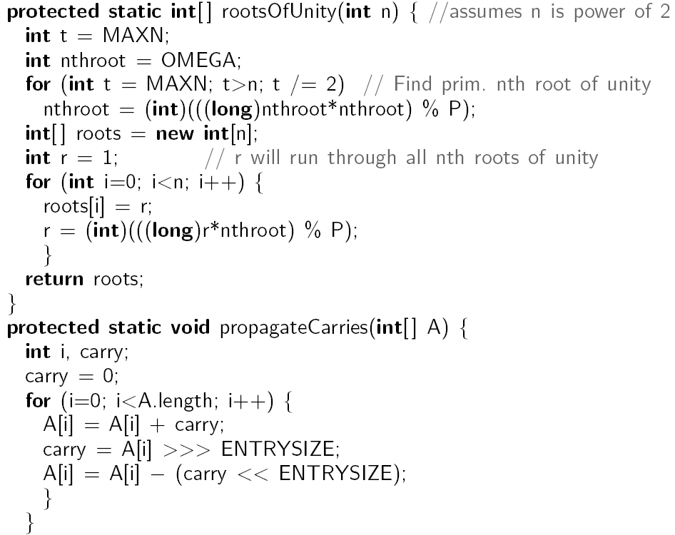
Support Methods for Java FFT in Z*_{p}

Slide 81

Non-recursive FFT
There is also a non-recursive version of the FFT
  Performs the FFT in place
  Precomputes all roots of unity
  Performs a cumulative collection of shuffles on A and on B prior to the FFT, which amounts to assigning the value at index i to the index bit-reverse(i).
The code is a bit more complex, but the running time is faster by a constant, due to improved overhead

Slide 82

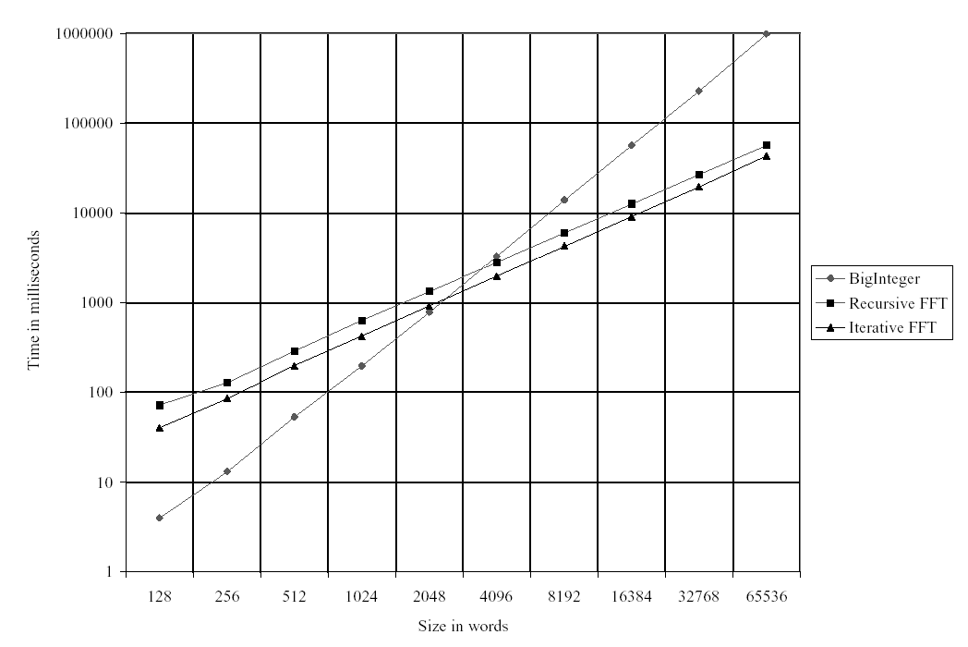
Experimental Results
Log-log scale shows traditional multiply runs in O(n²) time, while FFT versions are almost linear

